Slide 1
IMPLEMENTATION OF AES ALGORITHM
Sudheer Mandava
Gopi Para

Slide 2
Rounds and transformation stages
SubBytes
Shifting rows
Mixcolumns
Adding keys
Decryption
Live demo
Questions

Slide 3
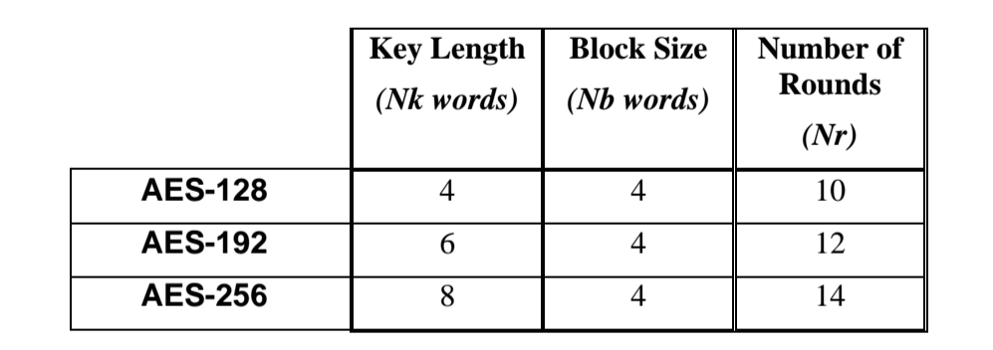
Rounds and Transformation stages
Transformation stages :
-Subbytes
-Shiftrows
-Mixcolumns
-Add Round keys

Slide 4
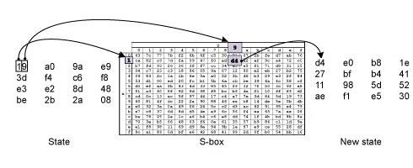
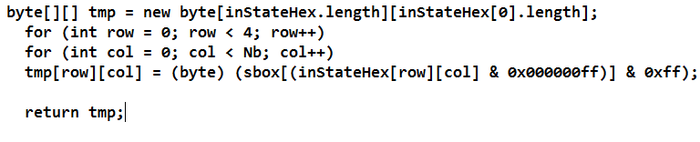
SubBytes()

Slide 5
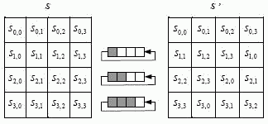
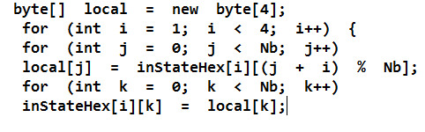
Shifting Rows

Slide 6
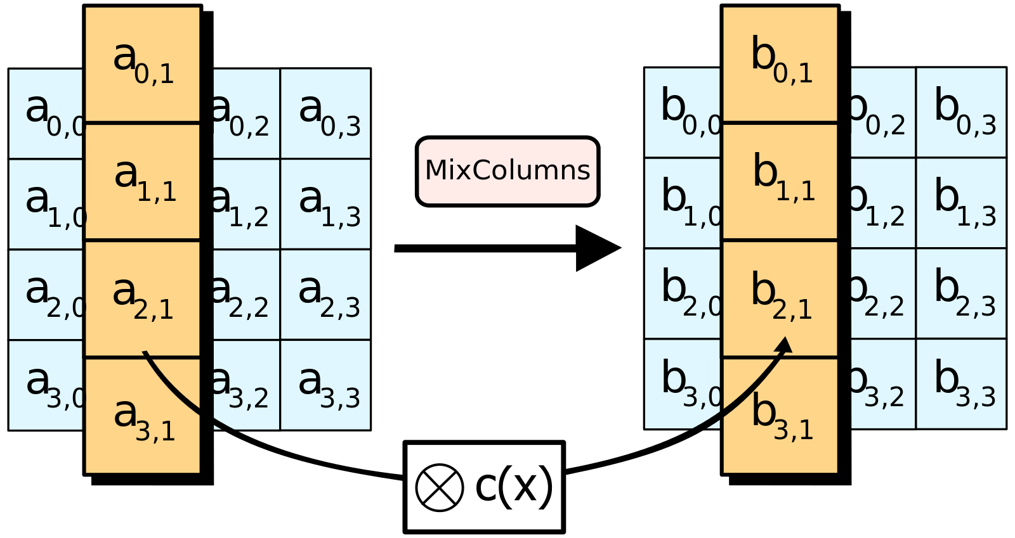
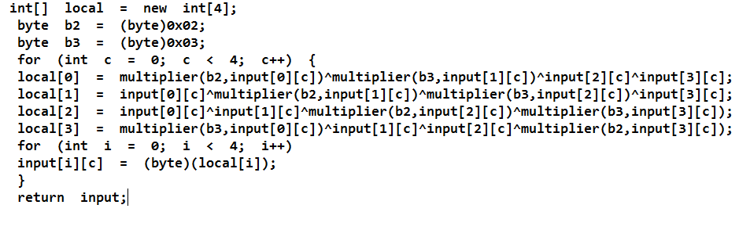
Mixcolumns

Slide 7
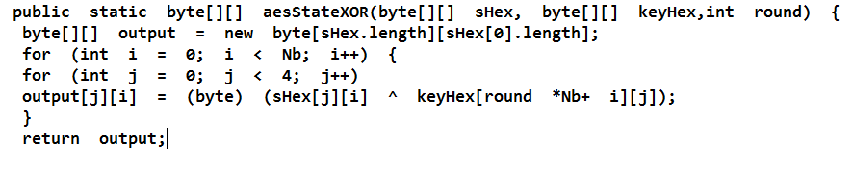
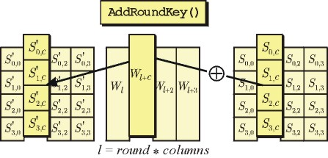
Adding rounds

Slide 8
Aes Decryption operation
AES decryption is accomplished using inverse if transformation in the appropriate order
invsubBytes
Invshiftrows
Invaddroundkeys
Inverse mix columns

Slide 9
Quick Demo

Slide 10


